Slide 1
Technical Audit of the Adult Census Income Algorithmic Decision-Support System
Group 32:
Sylvia Zhang, Hollan Yuan

Slide 2
Background
Group 32
Content
ADS task: Predict whether an individual's annual income exceeds $50K
Dataset: Adult Census Income dataset (UCI Machine Learning Repository)
Model implementation: Logistic Regression from a Kaggle notebook
Why we selected this ADS
Real-world ADS may optimize predictive accuracy at the expense of fairness
The selected implementation contains questionable preprocessing decisions and potential ethical blind spots
This ADS serves as a classical case study for Responsible Data Science auditing and connects directly to many concepts discussed in class.

Slide 3
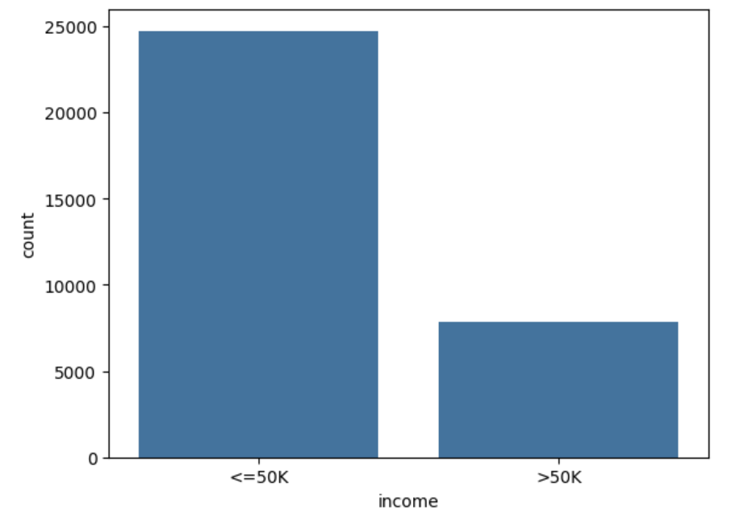
Input & Output
Group 32
Input:
14 socio-demographic and employment variables
Numerical: Age, fnlwgt, Education-num, Capital-gain, Capital-loss, Hours-per-week
Categorical: Workclass, Education, Marital-status, Occupation, Relationship, Race, Sex, Native-country
Output:
The final output of this ADS is a binary class label representing an individual's income bracket: either larger than $50K or less than $50K.
As seen in the count plot, the target class is highly imbalanced.
Key Observations:
Severe class imbalance in several input variables (Race ≈ 85% White, Sex ≈ 67% Male, Native-country ≈ 90% U.S.)
Some categorical features (workclass, occupation, native-country) contain missing values encoded as "?"; numerical features have no missing values
The original implementation imputes missing values using the mode

Slide 4
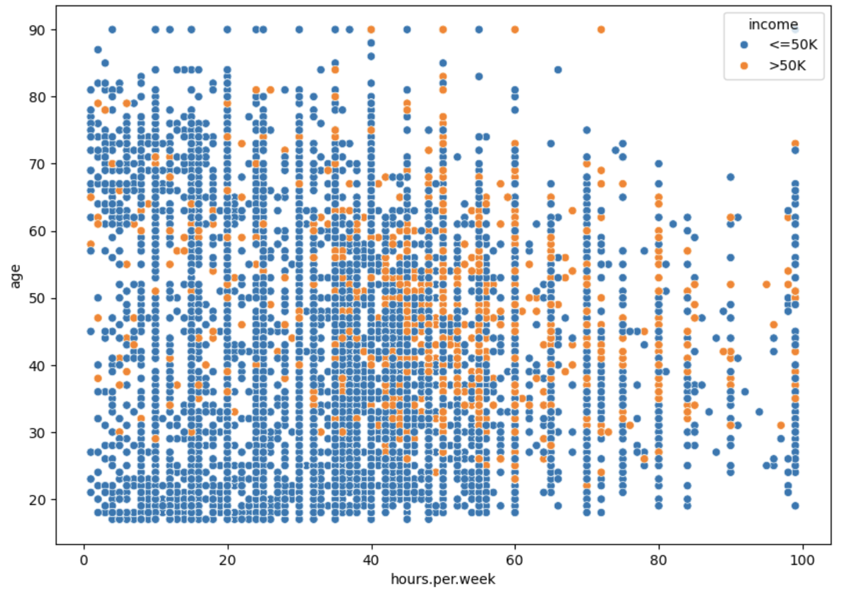
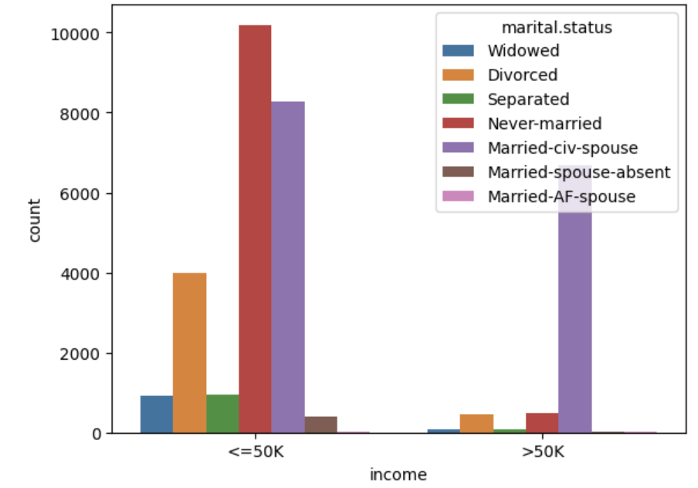
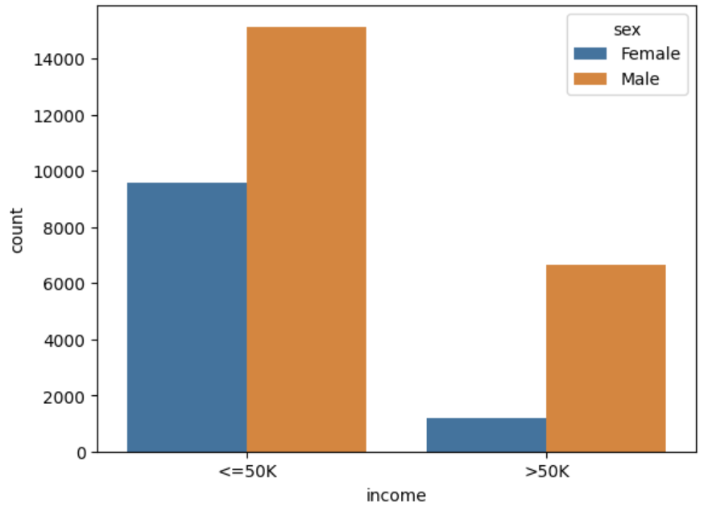


Preliminary Exploration
Group 32
Overall performance
Overall accuracy:85%
The reveals a critical issue: the number of False Negatives (FN = 664) is substantially higher than the number of False Positives (FP = 321). This discrepancy suggests that the model is actively biasing its predictions towards the majority class (less than $50K) to artificially inflate its overall accuracy.
2) Performance on subpopulation (Sex)
Women: accuracy 92% Men: accuracy 82%
This indicates that the model does not perform equally across demographic groups, even though the overall accuracy appears acceptable.

Slide 5
Detailed Analysis Plan
Group 32
Subpopulation analysis: Accuracy and error rates across demographic groups
Fairness metrics: Statistical Parity, Equal Opportunity
Intersectional fairness: Analyze combined subgroups (e.g., race × gender)
Proxy discrimination analysis: Identify whether features such as education or occupation act as proxies for race
Data preprocessing audit: Evaluate bias introduced by:
Mode imputation of missing values
Removal of extreme age values
Model interpretability: Analyze logistic regression coefficients to understand influential features

